Slide 1
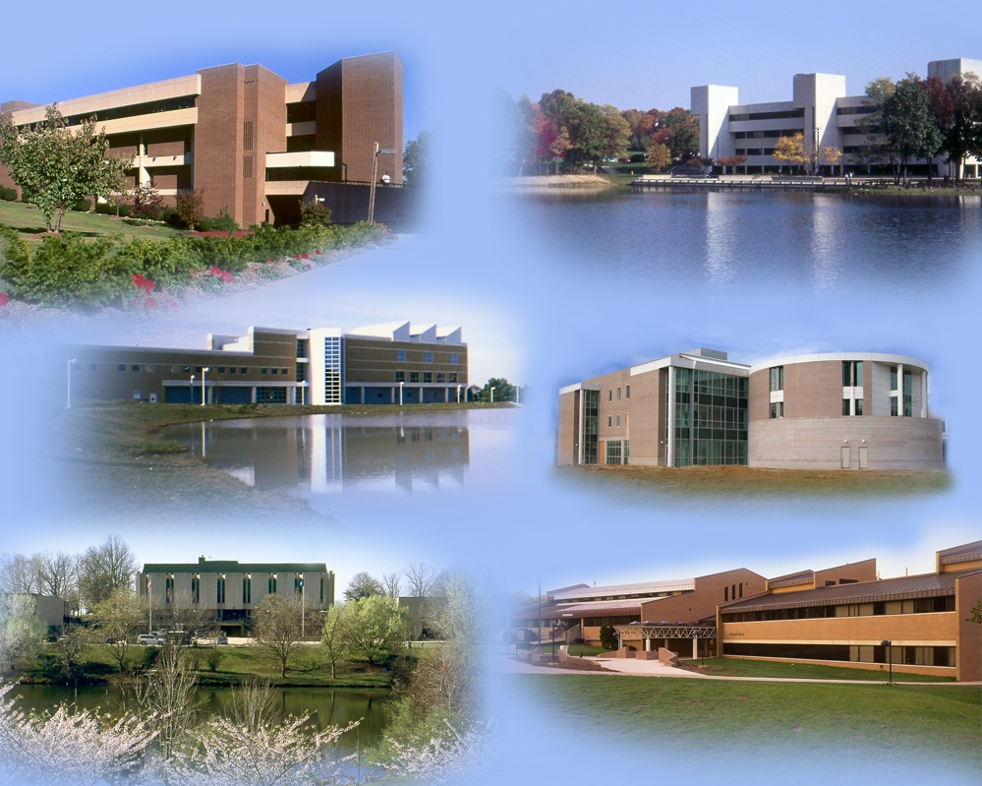
NOVA Northern Virginia Community College
Emergency Procedures at NOVA:
What Students Should Know
Office of Emergency Management

Slide 2
NOVA Northern Virginia Community College
Everyone has 10 minutes, right? In order to better prepare for an emergency, we ask each semester you take 10 minutes to:
2 minutes...
Sign up for NOVA Alert (alert.nvcc.edu). If you have already signed up, log in to make sure your most recent contact information is up to date.
8 minutes...
Go to nvcc.edu/emergency to review emergency procedures for events that may happen at NOVA.
To Prepare
Take 10 minutes to prepare by visiting: http://www.nvcc.edu/emergency
Office of Emergency Management

Slide 3
NOVA Northern Virginia Community College
BE PREPARED!!
NOVA wants you to be safe on Campus --- there is always the chance that an emergency situation may occur. Therefore, NOVA wants you to be prepared. Please take time to review safety and emergency information that NOVA provides through various resources. Your safety could depend on your knowledge of this information.
Emergency Phone Numbers:
College Police: 703-764-5000 – it is recommended that you program this number in your cell phone.
911
Office of Emergency Management

Slide 4
NOVA Northern Virginia Community College
LiveSafe App
NOVA has launched a new mobile safety app called LiveSafe !! The LiveSafe app allows you to:
Report tips to or request emergency services anonymously from NOVA Police.
Send your location to NOVA Police.
Let friends or family monitor your movements, so you never have to walk alone.
Share your concerns and suggestions with NOVA Police.
Have critical safety information at your fingertips.
Getting the app is fast, easy and FREE!
Visit the iTunes or Google Play Store and download the LiveSafe app (blue shield icon).
Choose NOVA from the list of schools.
Fill in your name and contact info, so we can reach you in the event of an emergency.
If you have any questions about LiveSafe, check out www.LiveSafeMobile.com or call NOVA Dispatch at 703.764.5000.
Office of Emergency Management

Slide 5
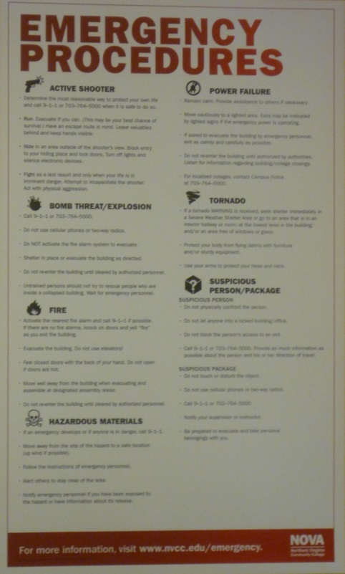
NOVA Northern Virginia Community College
Emergency Procedures Posters
Emergency Procedures Posters are displayed throughout the Campus. Please take time to review the valuable information.
www.nvcc.edu/emergency
Office of Emergency Management

Slide 6
NOVA Northern Virginia Community College
EMERGENCY PREPARATION
What You Should Know:
The two safest and most direct evacuation routes
Be familiar with your surroundings. Make sure you know the location of exits and the evacuation routes from your classrooms and other areas of the Campus.
Office of Emergency Management

Slide 7
NOVA Northern Virginia Community College
EMERGENCY PREPARATION
What You Should Know:
The location of designated Assembly Areas outside of the facility
If evacuating the building for an emergency, you should always exit the building through the closest/safest exit, then proceed directly to the nearest Assembly Area.
Faculty and Staff will be directing you to these areas.
Once in the area, STAY THERE until you are dismissed.
These areas are a safe distance from the building and will keep you from obstructing First Responders. It is unlawful to obstruct First Responders.
Office of Emergency Management

Slide 8
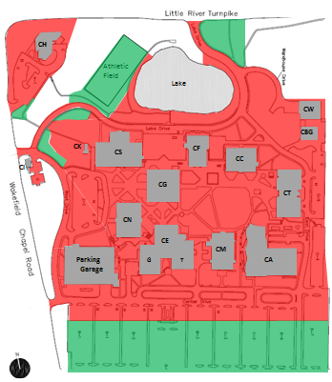
NOVA Northern Virginia Community College
Annandale Campus Assembly Areas
Areas in GREEN are designated as assembly areas during evacuations.
Areas in RED are potentially dangerous and designated for emergency response only.
Office of Emergency Management

Slide 9
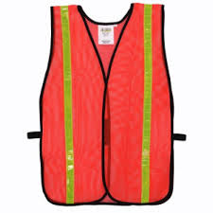
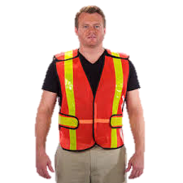
NOVA Northern Virginia Community College
Warden Program
NOVA has established a Warden Program, consisting of Faculty and Staff, who assist with evacuation and coordination of people during emergencies.
In the event of an emergency situation, follow directions from Wardens, who will be wearing orange safety vests.
Office of Emergency Management

Slide 10
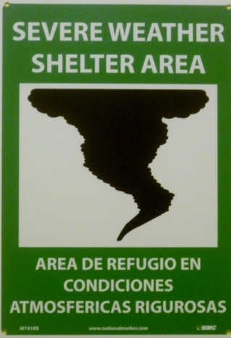
NOVA Northern Virginia Community College
EMERGENCY PREPARATION
What You Should Know:
Locations to Shelter-In-Place for a severe weather event
Shelter in these designated locations if the area is under a Tornado Warning or other hazardous weather condition.
Office of Emergency Management

Slide 11
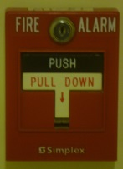
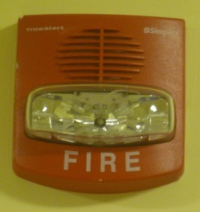
NOVA Northern Virginia Community College
FIRE
Activate the fire alarm
Call 911 if possible
Feel doors with the back of your hand before opening
Do not use elevators
Evacuate the building
If time, conditions and safety permit, take your personal belongings with you
Once outside, move away from the building and to a designated Assembly Area
Do not re-enter buildings until instructed to do so
Office of Emergency Management

Slide 12
NOVA Northern Virginia Community College
Hazardous Materials
Move away from the site of the hazard to a safe location
Call 911
Follow instructions of Emergency Personnel
Alert others to stay clear of the area
Notify Emergency Personnel if you have been exposed to the hazard or have information about its release
Office of Emergency Management

Slide 13
NOVA Northern Virginia Community College
Tornado
If the area is under a Tornado WARNING, seek shelter immediately. Go immediately to:
The nearest Severe Weather Shelter Area
OR
An appropriate area that will provide protection (closets, interior rooms, interior hallways)
Stay away from corners, windows, doors, and outside walls
Put as many walls as possible between you and the outside
Use your arms to protect your head and neck. Protect your body from flying debris with any available furniture or sturdy equipment
Office of Emergency Management

Slide 14
NOVA Northern Virginia Community College
Tornado
Contingency Plans:
Automobiles – Get out of your vehicle and try to find shelter inside a sturdy building. A culvert or ditch can provide shelter – lie down flat and cover your head with your hands.
Outdoors – Try to find shelter in a sturdy building. If no buildings are close by, move away from the tornado’s path at a right angle. If there is not time to escape, lie down in a ditch or depression and cover your head with your hands.
Office of Emergency Management

Slide 15
NOVA Northern Virginia Community College
Earthquake
If you are indoors, stay there until the shaking has stopped:
DROP to the floor
COVER by getting under sturdy furniture
HOLD ON until the shaking stops
Stay away from glass, windows, outside walls or doors, and anything that could fall on you.
If you are outdoors, move away from buildings, overhangs, trees, and/or power lines to a clear area.
Office of Emergency Management

Slide 16
NOVA Northern Virginia Community College
Earthquake
Once the shaking has stopped:
Exit the building when safety permits and move to a designated Assembly Area
Be aware that utilities such as gas, power, and water lines may be damaged
Help injured persons
Expect aftershocks
Use the telephone only for emergency calls
Office of Emergency Management

Slide 17
NOVA Northern Virginia Community College
Power Failure/Outage
Remain Calm
Move cautiously to a lighted area
Provide assistance to others
Evacuate the building only if directed to do so
Do not re-enter building until authorized
Monitor NOVA Alert and Media Outlets for campus closings/updates
Office of Emergency Management

Slide 18
NOVA Northern Virginia Community College
Reporting Dangerous Situations
You are required to notify the Northern Virginia Community College Police Department at 703-764-5000 of any situation or incident that involves a significant emergency or danger that may pose an immediate or on-going threat to the health and safety of students and/or employees on campus.
Help us keep your Campus SAFE!
Office of Emergency Management

Slide 19
Alert Technology at NOVA
NOVA Northern Virginia Community College
Classroom Phones
Website
EMAIL
Blackboard
TV CRAWL
Visual Messaging System
Pop Up Alerts
(Networked Computers)
AM Radio Transmitter
Early Warning Alert System
NOVA Alert(Text Messaging)
800 MHZ Radios
Office of Emergency Management

Slide 20
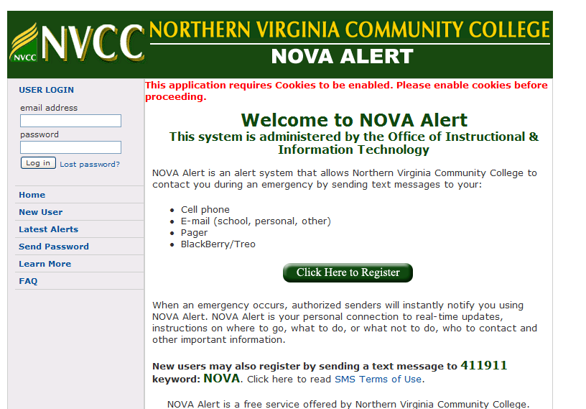
NOVA Northern Virginia Community College
Have you signed up for NOVA Alert??
https://alert.nvcc.edu
Emergency Text Alerting System
Sign up today!
Important emergency information
College Closings/Delays
Communication tool
Office of Emergency Management

Slide 21
NOVA Northern Virginia Community College
Drills
At a minimum, NOVA will conduct the following Drills annually:
Fire
Tornado
Earthquake
Alert Notification
**If you are on Campus during a Drill, NOVA requires you to participate.
Office of Emergency Management

Slide 22
NOVA Northern Virginia Community College
Thank you!!
NOVA and the Office of Emergency Management and Safety (OEMS) appreciate your effort in making this NOVA Campus a safe and rewarding place to attend school.
Should you desire further information on how to be prepared, please contact the Office of Emergency Management and Safety at OEM@nvcc.edu or visit the OEMS website at www.nvcc.edu/emergency. You can also view available resources from FEMA at www.ready.gov.
Office of Emergency Management

